Slide 1
InstaWeight
Supervised By: Dr. Akhlaque Ahmed & Folio 3
Atif Mehmood
Ateeb Ahmed
Sayyada Sahar Fatima

Slide 2
Problem Statement
Weight - The most important Factor in livestock business, effective in assessing the reproductive efficiency and growth performance of an animal. [1]
Weight - To measure the correct dose of therapeutic pharmaceutical to treat diseases. [2]
Feed Based on Animal’s Weight, avoids underfeeding or overfeeding. [2]
Weighing animal - A tedious and time consuming task, requires manhandling. [3]

Slide 3
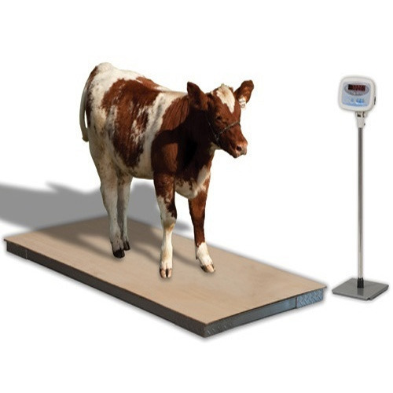
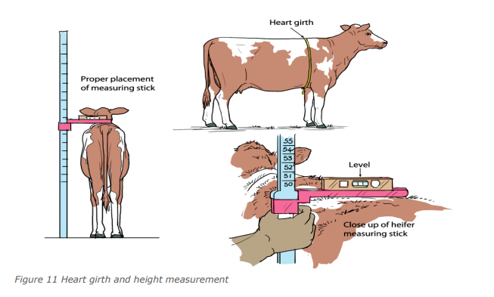
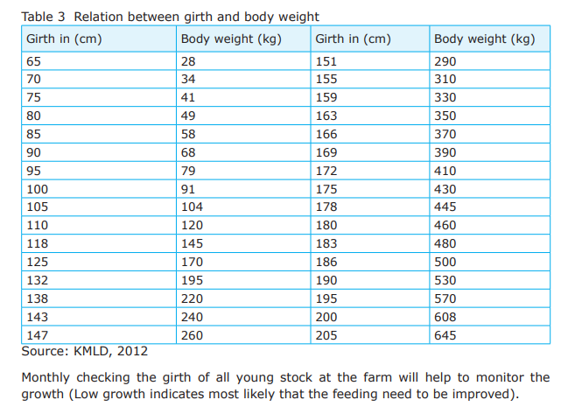
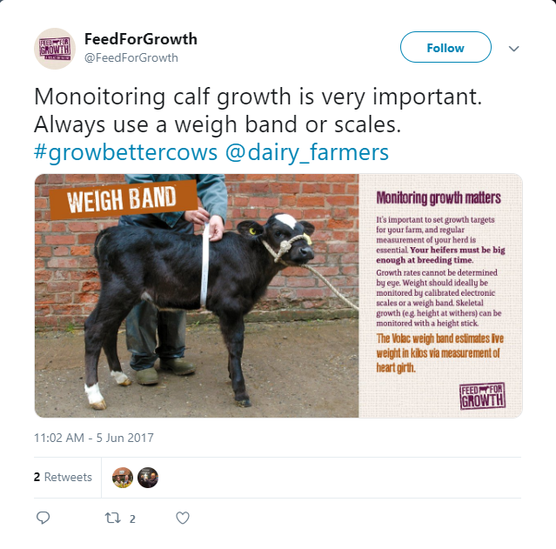
Existing Methods
Electronic Scale
Height, Heart Girth
Weigh Band

Slide 4
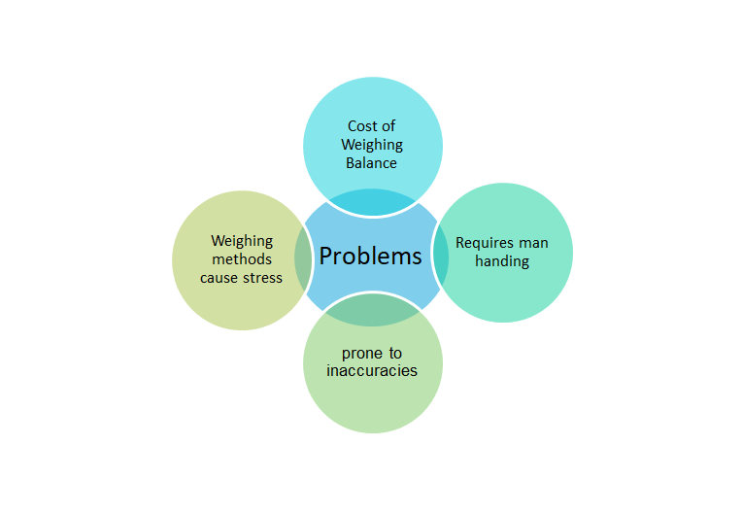
Problems with Existing Methods
https://www.farmersweekly.co.za/farm-basics/how-to-livestock/stress-affects-livestock-health/

Slide 5
Our Proposed Solution
A Computer Vision based solution
uses depth camera for depth information.
Features (Heart Girth) from the image.
Weight estimation on estimated features and their depth.
An admin panel to save and maintain weight.

Slide 6
Our Approach

Slide 7
Heart Girth Measurement with Per-Pixel Depth
Heart girth measurement is the most reliable technique of estimating the weight
This approach:
Require 1 images
Find inner and outer bounding boxes around the required body parts of animal from the Image of side view of the animal
Estimate the curvature using per pixel depth information
Conversion of measurements
Weight Estimation
Notes:
The second approach we looked into was the heart girth measurement with per pixel depth. We take the same measurements as the first approach. However this time we estimate the curvature using per pixel depth information

Slide 8
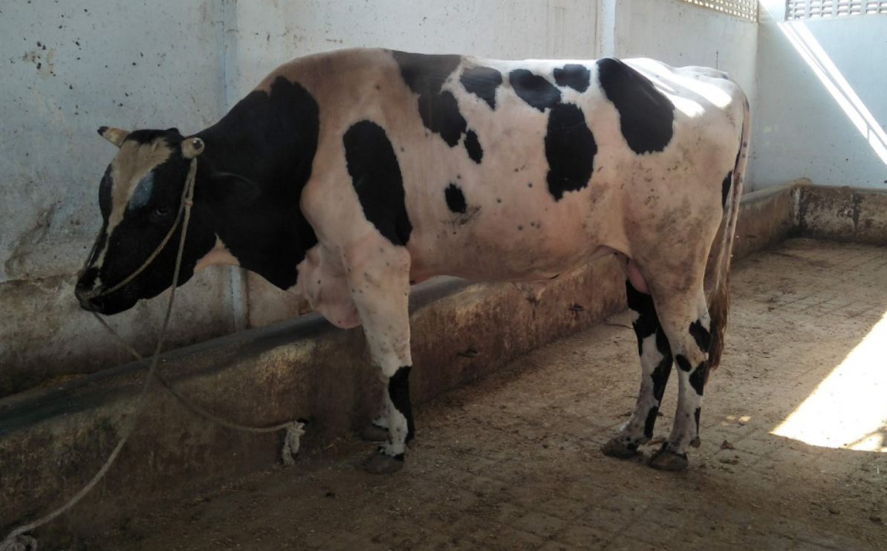
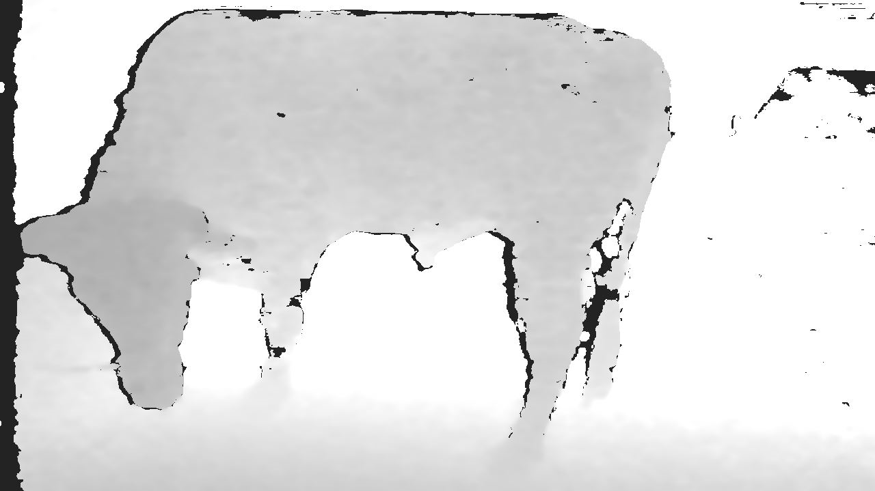
Workflow
Image Acquisition:
Original Image
Depth Image

Slide 9
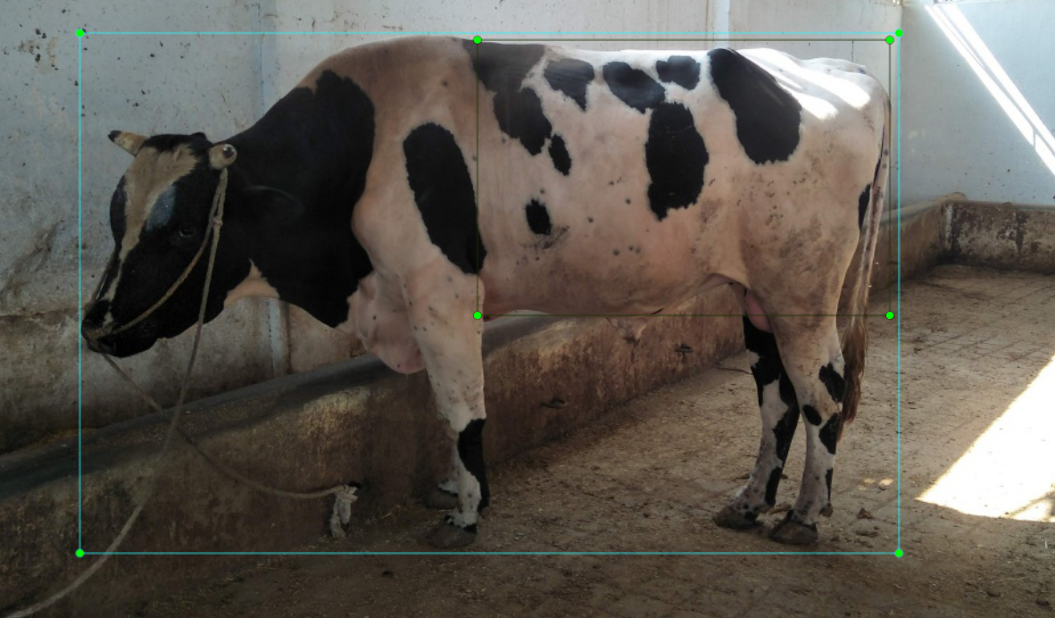
Workflow
2. Object Localization:

Slide 10
Workflow
3. Pixel Values and depth values:
2 measurements:
Heart Girth Measurements:
Heart Girth Pixel Vector: [p1, p2, p3 … pN]
Heart Girth Depth Per Pixel Vector: [dp1, dp2, dp3 … dpN]
2. Diagonal Pixel Vector
Diagonal Pixel Vector: [p1, p2, p3 … pN]
Diagonal Depth Per Pixel Vector: [dp1, dp2, dp3 … dpN]

Slide 11
Workflow
3. Conversion of Obtained measurements into real world measurements
Heart Girth Pixel Vector
Measurements Converter
Heart Girth Measurements in meters
Diagonal Pixel Vector

Slide 12
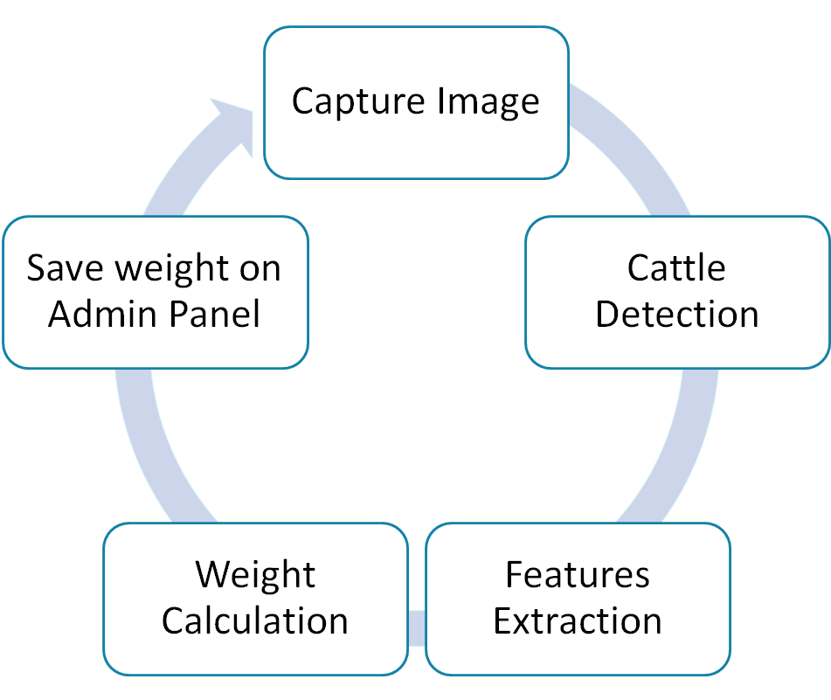
Workflow In a Glance

Slide 13
Assumptions
One animal in a frame.
Breed specific work
Intel realsense D-415 - For Image acquisition.

Slide 14
Dataset Collection

Slide 15
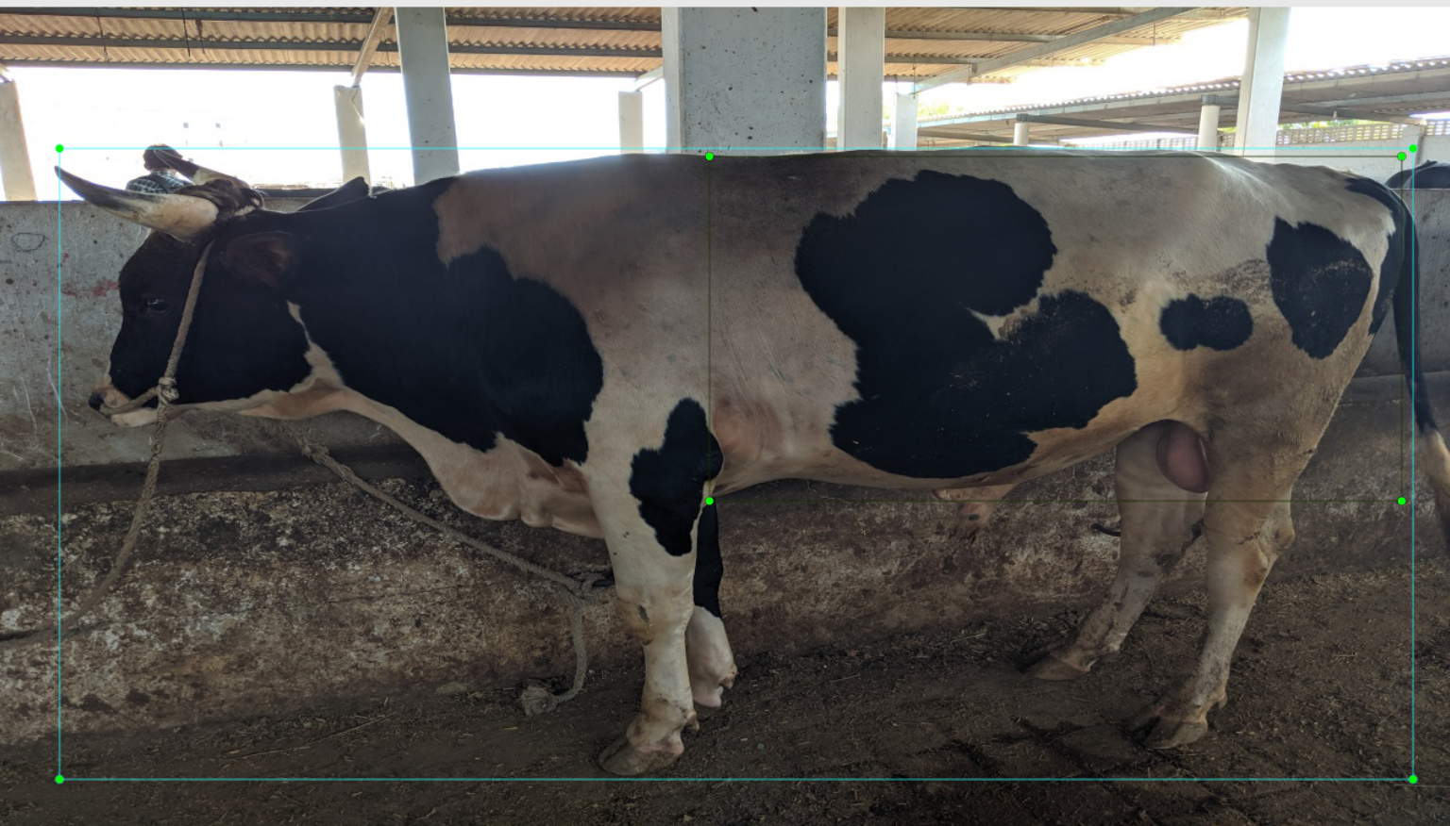
Dataset V1
Hand annotated images: 229 of ~90 animals
Useable images from Images scrapped from web: 277
Only side views of Cattle
No depth information
No weight labels
Used for Semantic Segmentation and Cattle detection
Total Images: 506

Slide 16
Augmentation on V1
From each image - 3 augmented images
Brightened Image (gamma = 2.0)
Darkened Image and introduced noise to simulate low light conditions.
Flipped Images on vertical axis
Total Number of Images after Augmentation: 2,024

Slide 17
Dataset V2
Hand annotated images of ~65 animals with depth: 1235
Only side views of Cattle
No weight labels
Will be use for Semantic Segmentation and Cattle detection
Total Images 1235 with depth , 2024 without depth

Slide 18
Annotations

Slide 19

For Object Localization

Slide 20
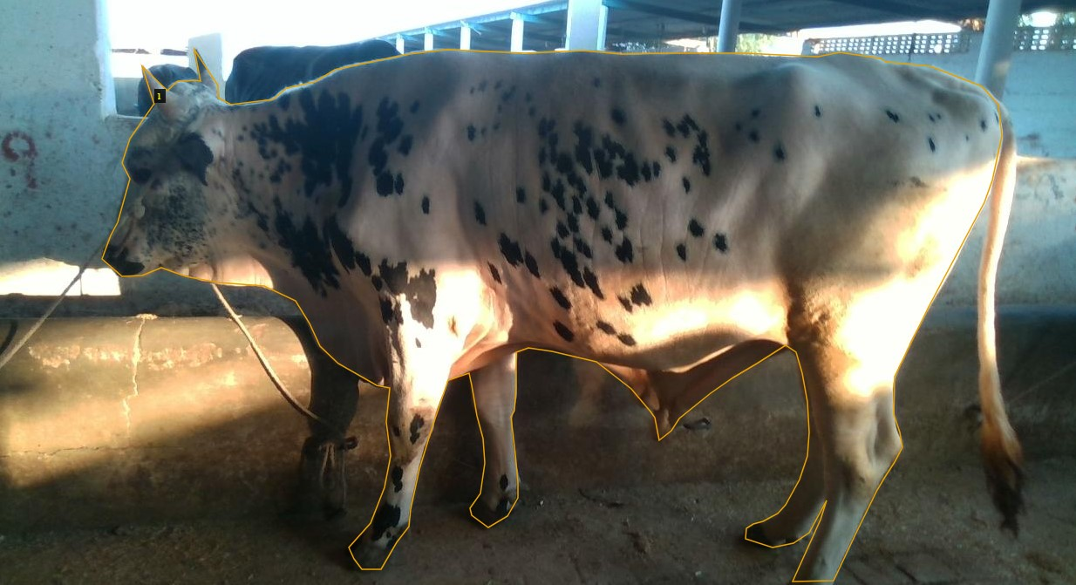
For Semantic Segmentation

Slide 21
Experiments

Slide 22
Object Localization

Slide 23
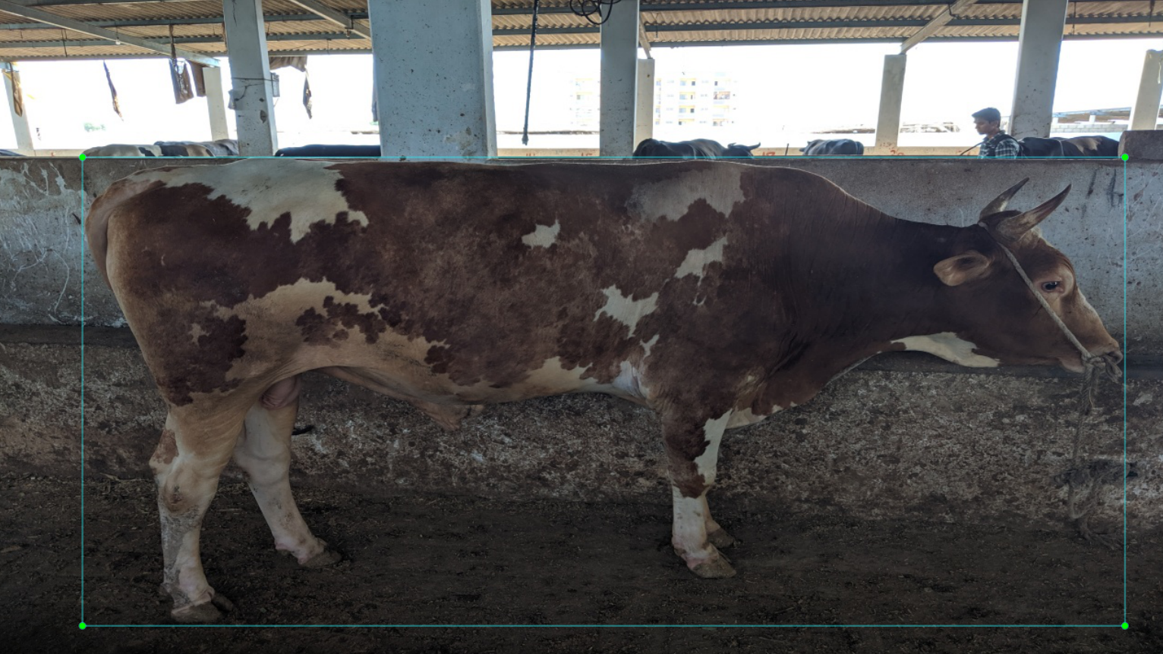
Aim: Object Localization
Take a bounding box around animal

Slide 24
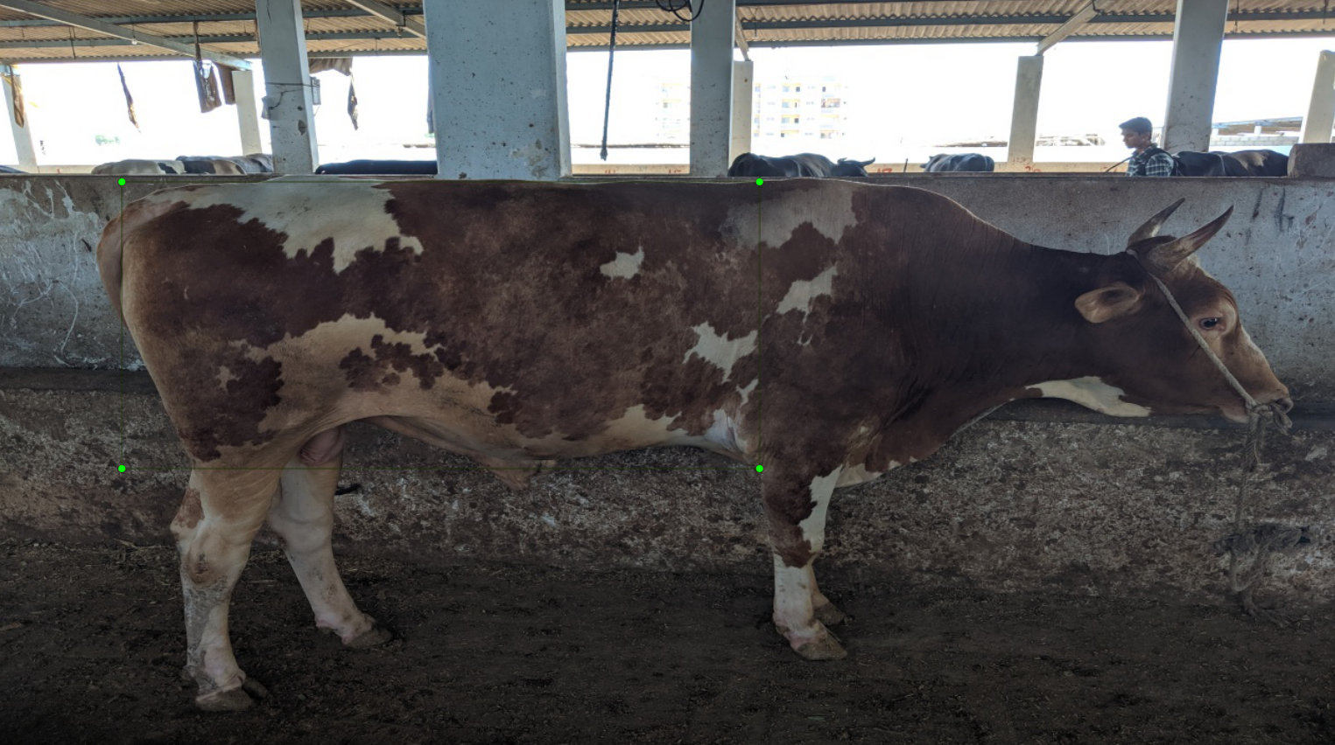
Aim: Object Localization

Slide 25
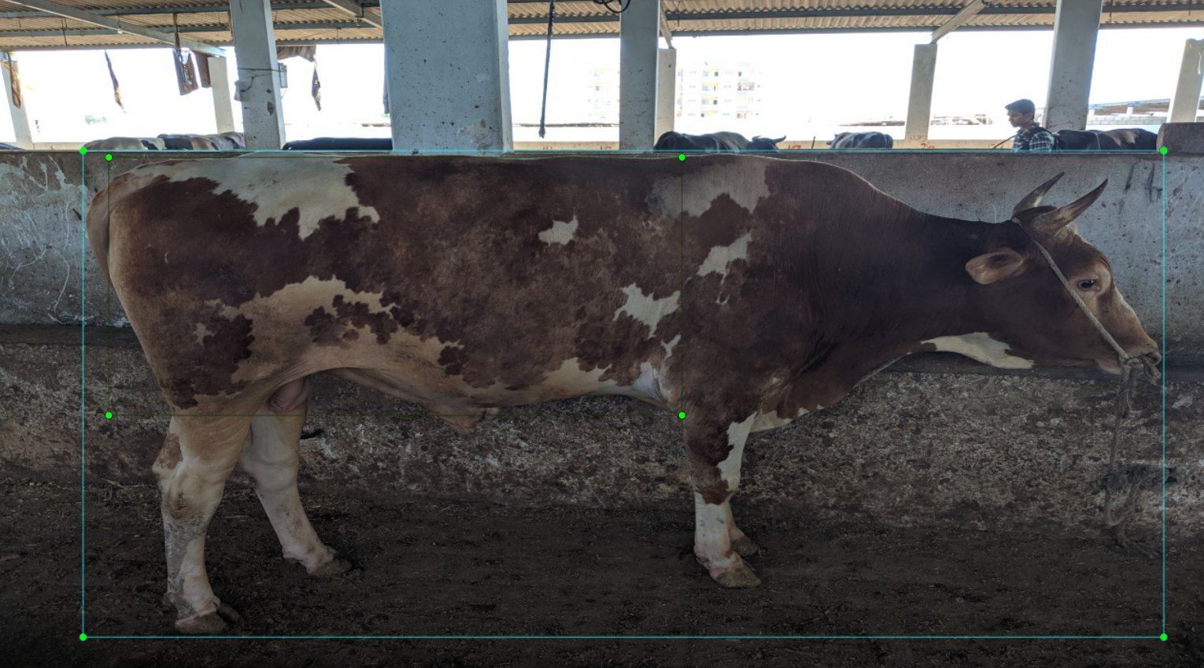
Combined Both

Slide 26
Experiments on Dataset V1
Tried to solve as a Localization problem
Base networks VGG16, Resnet
Initial trained only fully connected layers for two bounding boxes.
Trained only fully connected layers for only one bounding box.
Unfreeze some Conv layers and trained for two bounding boxes.
Unfreeze some Conv layers and trained for one bounding boxes.
GAP for Localization

Slide 27
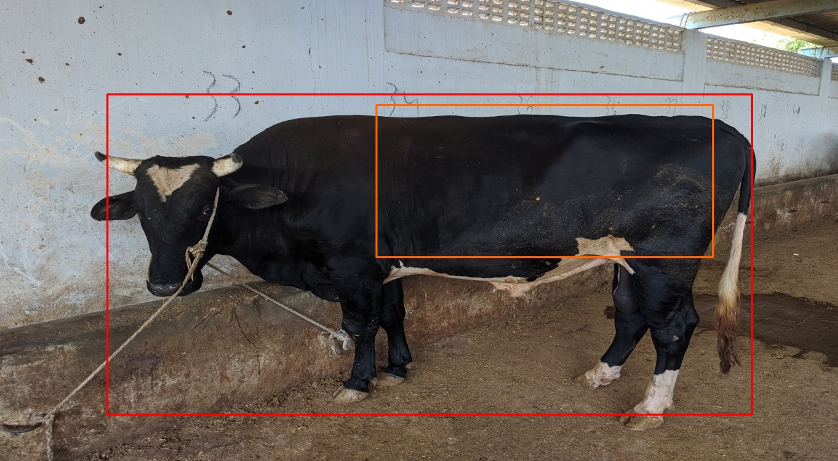
Results on V1

Slide 28
Experiment on Dataset V2
Cropped Cow Images and tried to predict inner bounding box
Assumption was it will learn better features because it has less background compare to the whole image but didn’t worked.

Slide 29
YOLO

Slide 30
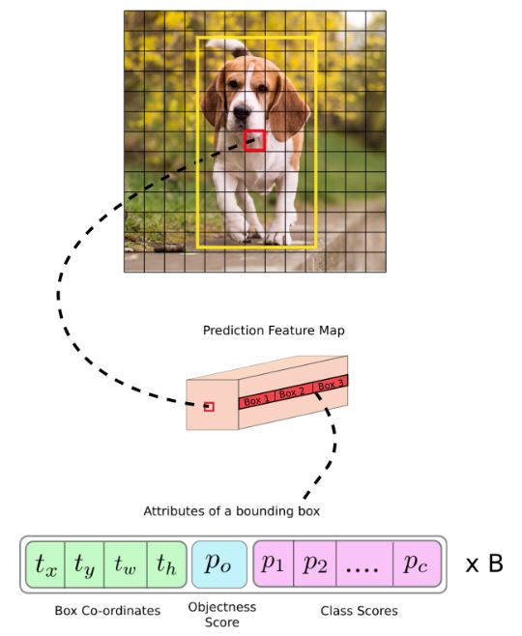
A Word about YOLO
Divide the image into 13x13 grid
Feature Extraction using DarkNet
Bounding boxes for each cell ( 9 anchors)
Filter b_boxes using Objectness Score
Filter again using NMS and IoU
Output

Slide 31
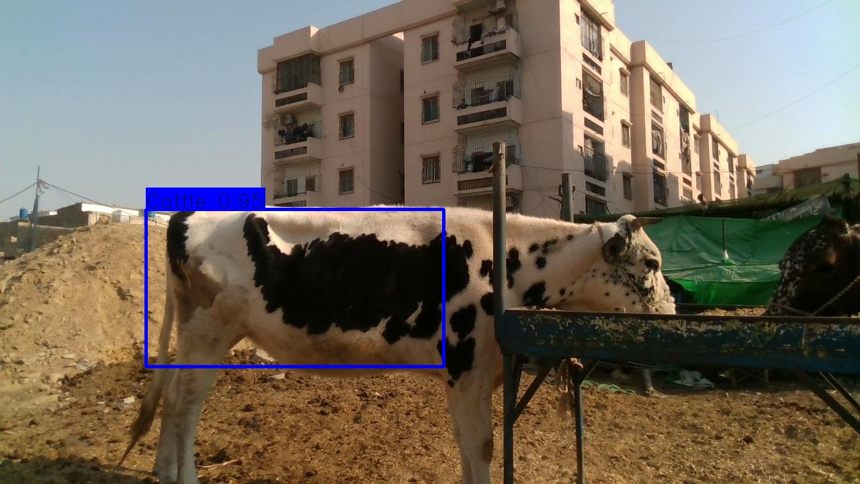
Yolo

Slide 32
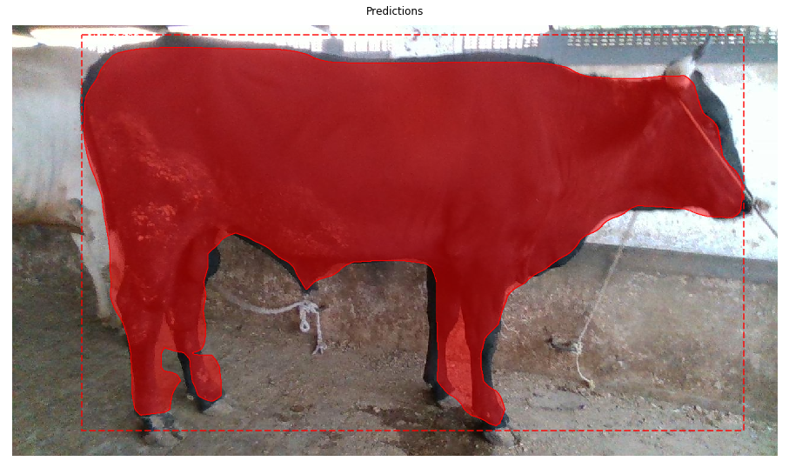
Future directions
Better coverage of cattle using Mask RCNN
More robust and reliable body features
A more natural approach
https://drive.google.com/file/d/1sGvSAdqIqdxZadLFDWyJmHaGyRM2r_N4/view?usp=sharing

Slide 33
Challenges
Weight Labelled Dataset

Slide 34
Conclusion
Developed Admin Panel Successfully.
Developed Sub Programs to estimate the weight of cattle, given depth vectors.
Developed YOLO object detector, which is significantly better than localization approaches.
Mask RCNN is even better in terms of segmentation and will be experimented with as soon as a weight labelled dataset is available.

Slide 35
References
H. Steinfeld is Senior Officer (Programme, Policy and Planning) and S. Mack is Animal Production Officer (Rural Development) in the Animal Production and Health Division, FAO, Rome, Italy
Why Weigh and What is EID ? (2019). (Datamars Limited) Retrieved from TRU -TEST.
Chintan Bhatt, Aboul-ella Hassanien, "Barqi breed Sheep Weight Estimation based on Neural Network with Regression." (Charotar University of Science and Technology, Gujarat, INDIA

Slide 36
Demo

